Slide 1
Smart Agent Recruitment Challenge
EDA Project – 2
-Vikram Singh

Slide 2

Why we are here?
We have the recruiting data of agents of the “FinMan” which is a Financial Distribution Company having distribution channel across India and they sell their products by their agents.
Managers of the FinMan are primarily responsible for hiring the agents.
Once the agents provides their consent then in the next 3 they undergo 7 days training and have to clear subsequent exams to become agents.

Slide 3

What we have to do?
As FinMan makes significant investment in identifying, training and recruiting the agents but there are significant Agents doesn’t meets the expectations.
FinMan wants to Analyse the overall past recruiting data to derive meaningful insights.

Slide 4

Data we have…
Applicants:
Application Receive Date
Gender
Birth Date
Marital Status
Occupation
Qualification
Managers:
Date of Joining
Joining Designation
Current Designation
Status
Gender
Birth Date
Business
Products
Agents recruited
Application Sourced

Slide 5
Classification of Data Before EDA
Applicant Age:
Less than 25 : YA_Appli.
Between 25 and 50 : AA_Appli.
Greater than 50 : SA_Appli.
Manager Age:
Less than 35 : YA_Man.
Between 35 and 50 : AA_Man.
Greater than 50 : SA_Man.
Manager Experience:
Less than 2 : New_Man.
Between 2 and 5 : Sen_Man.
Greater than 5 : Exe_Man.

Slide 6
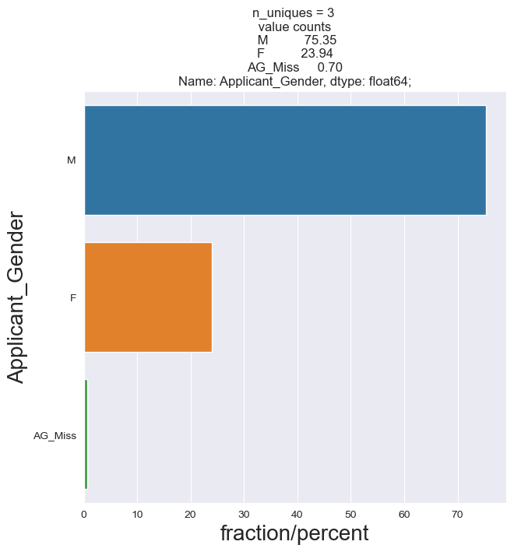
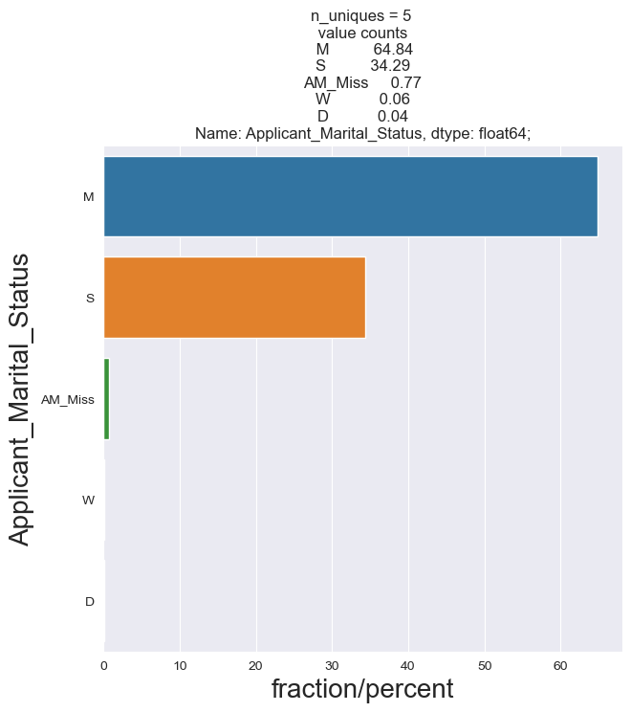
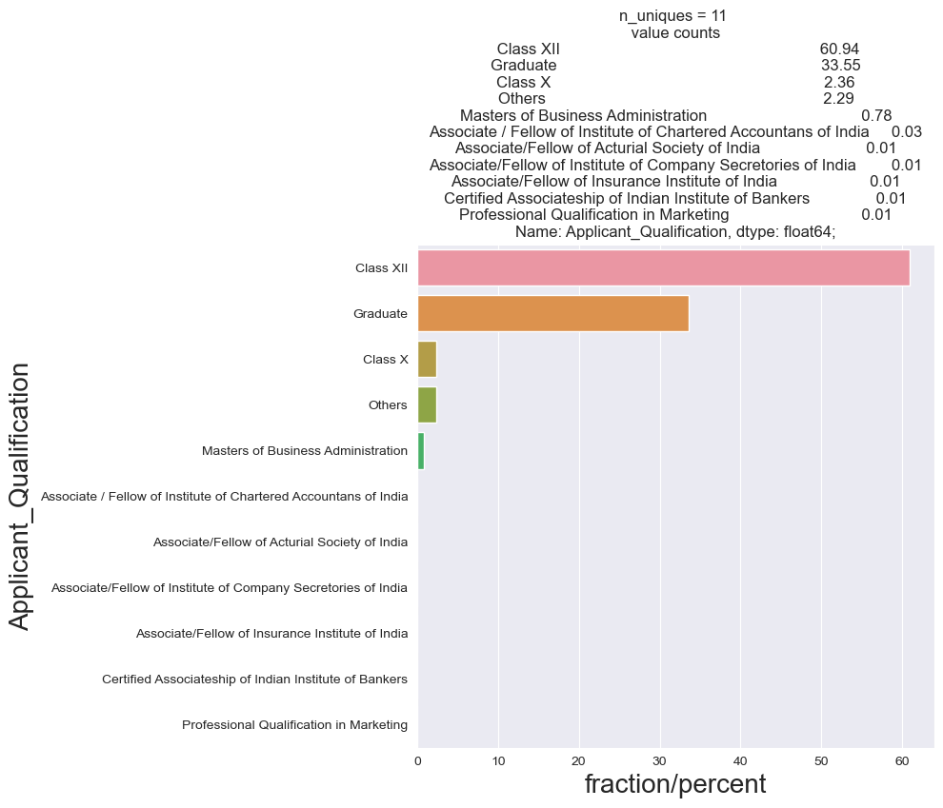
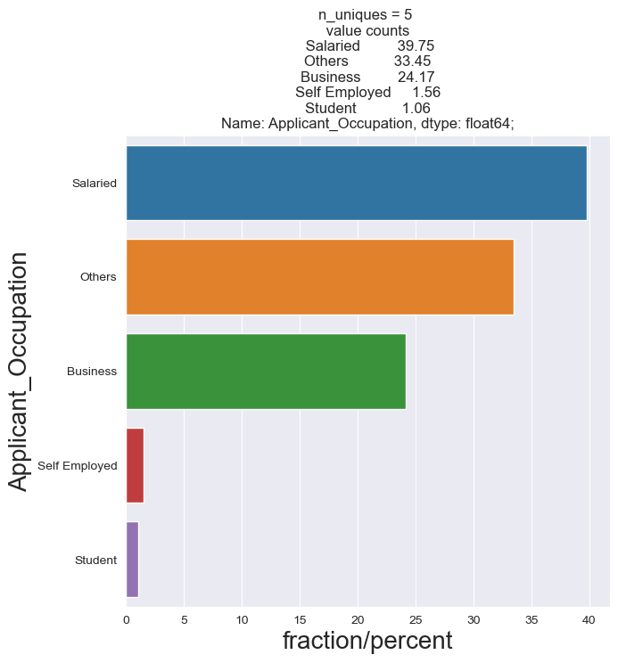

Slide 7
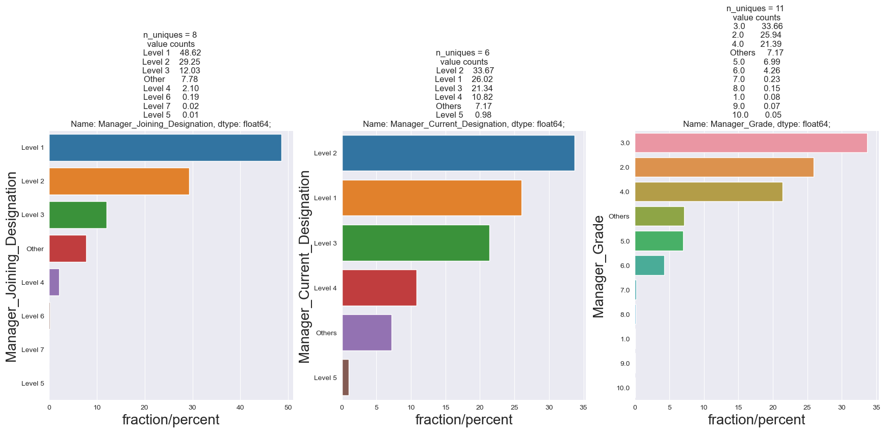

Slide 8
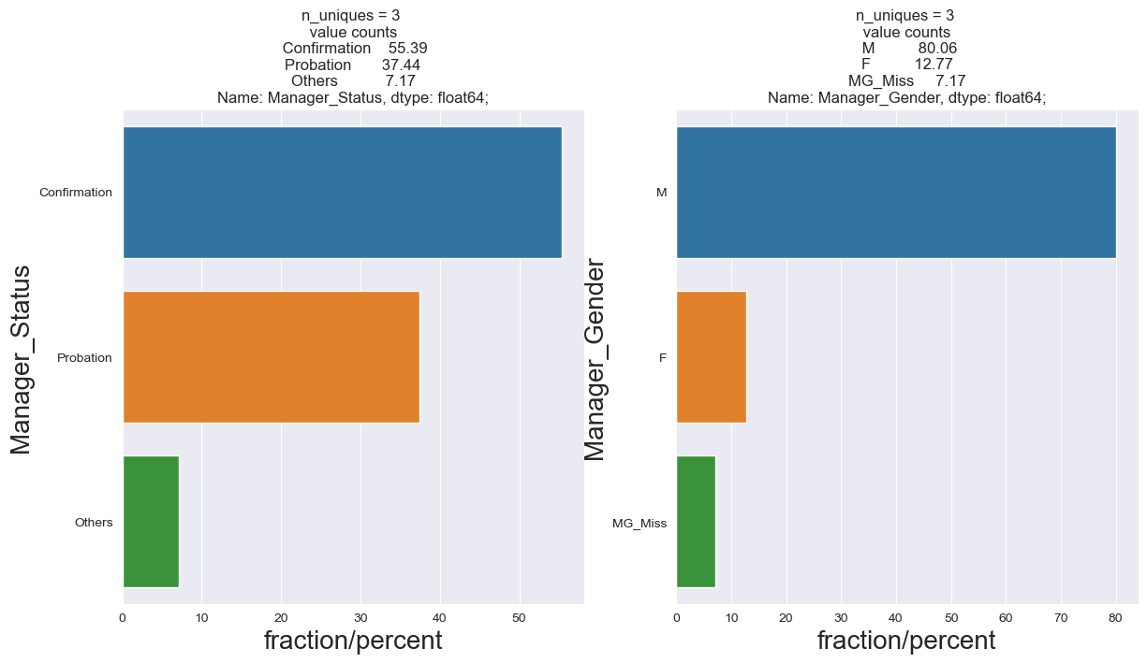
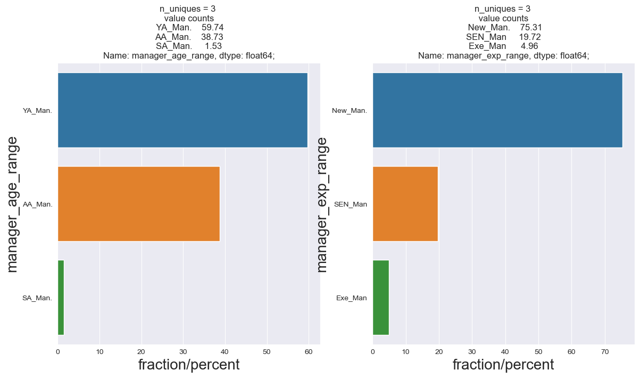

Slide 9
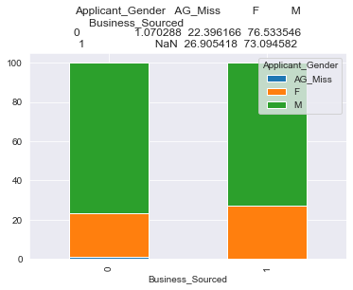
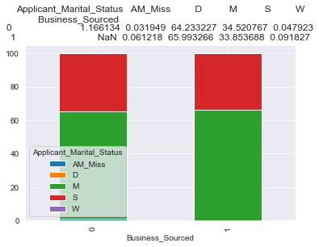
Nearly 73% of male applicant are more likely to be Agents.
Nearly 65% of married applicants are more likely to Agents.

Slide 10
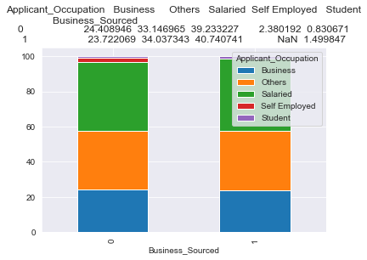
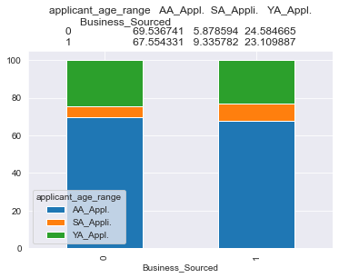
Nearly 41% of Salaried Applicants are more likely to be Agents.
Nearly 67.5% of Adult Age Applicants are likely to Agents.

Slide 11
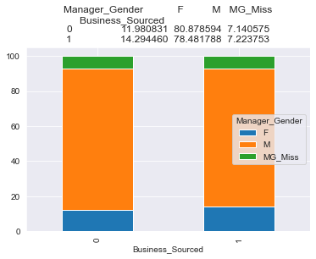
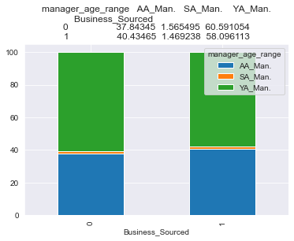
Under the male managers applicants are more likely to be agents.
Under the Young managers applicants are more likely to be agents.

Slide 12
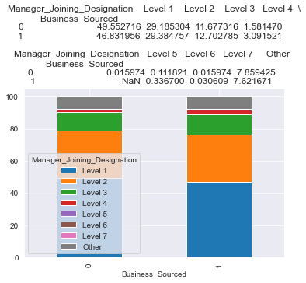
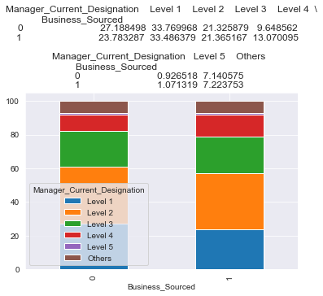
Under the managers whose Joining designation is level-1, applicants are more likely to be agents.
Under the managers whose current designation is level-2, applicants are more likely to be agents.

Slide 13
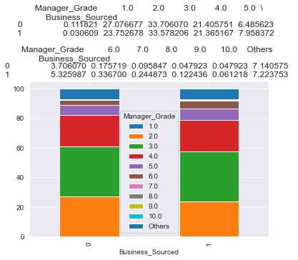
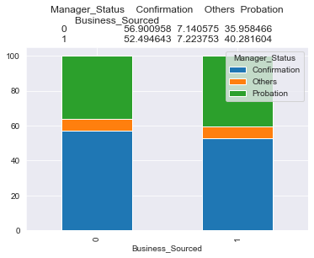
Under the Manager grade-3 Applicants are more likely to be Agents.
Under the Confirmed Managers, Applicants are more likely to be Agents.

Slide 14
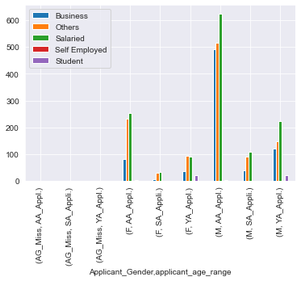
Male Applicants who are salaried and of age between 25-50 years age are more likely to be Agents.

Slide 15
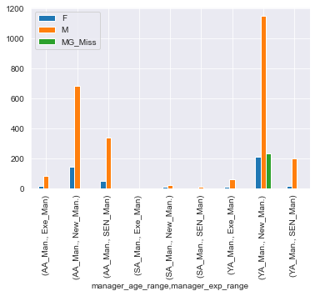
Under the male managers of age less than 35 and having experience less than 2 years, applicants are more likely to be agents.

Slide 16
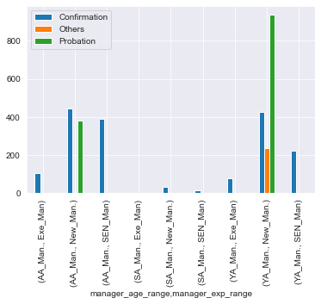
Under the probation managers of age less than 35 and having experience less than 2 years, applicants are more likely to be agents.

Slide 17
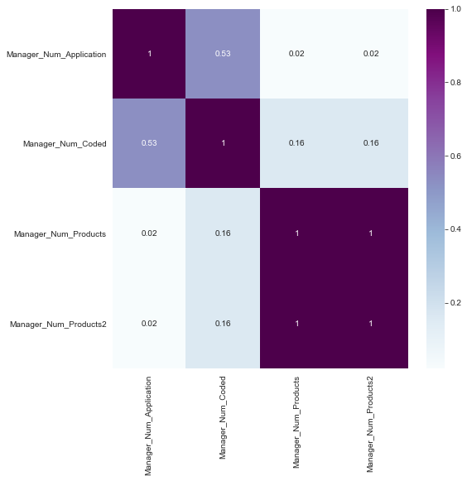
Manager Num Application and Manager are correlated

Slide 18

Conclusion:
Male Applicants who are salaried and of age between 25-50 years age are more likely to be Agents.
Under the male managers of age less than 35 and having experience less than 2 years, applicants are more likely to be agents.
Under the probation managers of age less than 35 and having experience less than 2 years, applicants are more likely to be agents.

Slide 19

Recommendations:
Senior managers of age greater than 35 years and having experience of age greater than 2 years have to be more involved in the recruitment process.

Slide 20
Thank - You

